Slide 1

Big Data Storage
Hadoop Distributed file System(HDFS)

Slide 2

BIG DATA
HDFS – Writing a file
Big Data –Definition
Characteristics 4V’s
HDFS
1. Why HDFS?
2. What is HDFS?
3. How a file gets stored in HDFS?
Data Node
Name Node

Slide 3
HDFS Operations

Slide 4



HDFS
How to achieve fault tolerance by replication?
Cluster
File gets separated as Blocks
Blocks reside at the Data Node
All block information reside at Name node
Name Node
All running in Commodity Hardware
Data Node 1
Data Node 2
Data Node 3
Data Node 4

Slide 5
HDFS
Challenges in Distributed Storage
How to manage Data Node Failure?
How to manage Name Node Failure?
Replication Factor

Slide 6
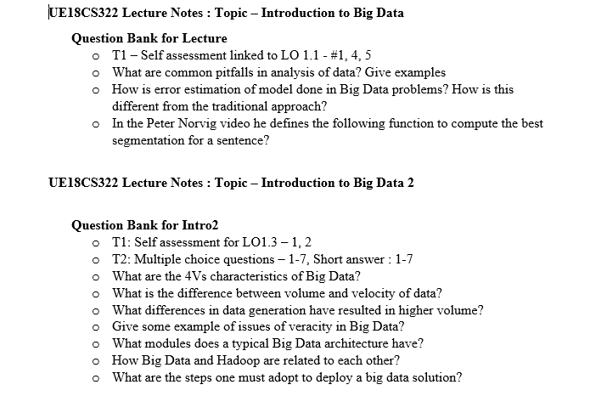

HDFS
Replication Factor
No single machine stores the entire file
Data Node 1
Data Node 2
Data Node 3
Data Node 4
Data Node 5

Slide 7
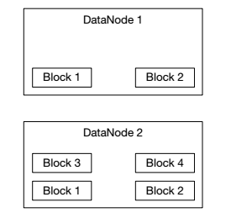
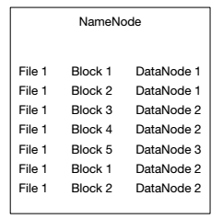
HDFS
Replication Factor
Replication Factor is a configuration property that can be set
Number of copies depend on the replication factor

Slide 8
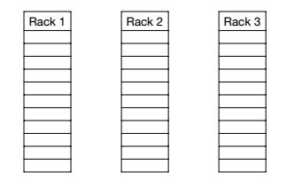
HDFS
How to choose the location for these replicas?
Replicas
Fault Tolerance
= More Redundancy means highly fault Tolerant
Bandwidth
= Far write locations should be avoided

Slide 9
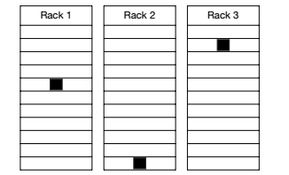
HDFS
How to choose location for replicas?
Should we put replication in all three racks to preserve fault tolerance?
If we do so intercluster bandwidth increases
Trade-off

Slide 10
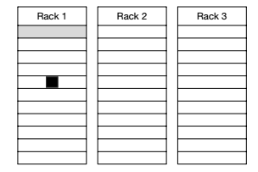
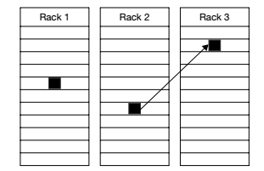
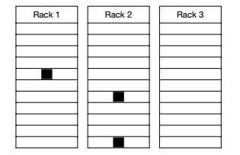
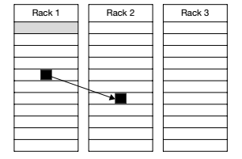
HDFS
Typical write for replicas
Bit Expensive

Slide 11
Data Node Failure Management
How Name node handles?
You have a cluster with 7 data nodes. Suddenly one data node goes down. How name node handles this failure?

Slide 12
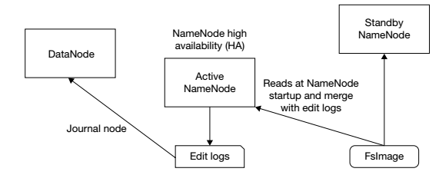

HDFS
Name Node Failure Management
Use of Metadata Files
Using a Secondary Name node
Disadvantages
Metafiles as Backup
Resource Intensive operation

Slide 13
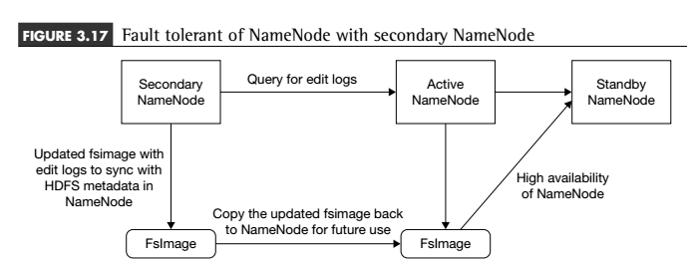
HDFS
Name Node Failure Management-Secondary Node
Checkpointing

Slide 14
BIG DATA
Secondary Namenodes
keeps a copy of NameNode meta data.
Secondary node
merges the metadata files to obtain an updated Fsimage
Stored meta data
Primary and secondary sync up the data
Checkpointing
To free namenode from task of merging
Why?

Slide 15
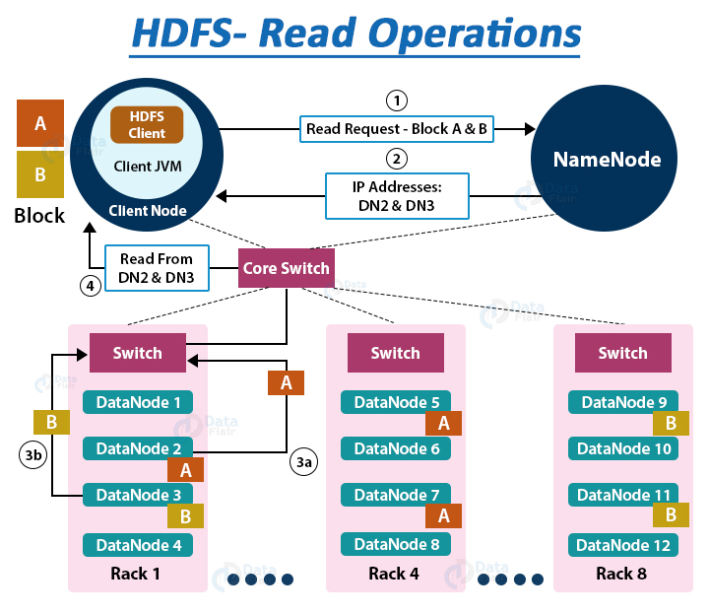
HDFS Read and Write Operations
HDFS – Reading a file

Slide 16
HDFS Read and Write Operations
HDFS – Reading a file

Slide 17
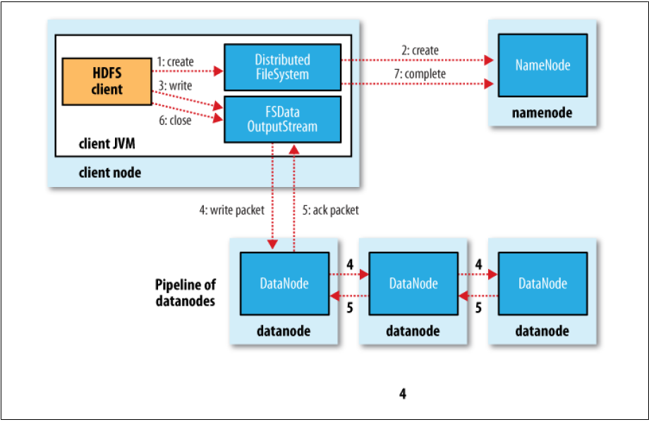
Writing a File
BIG DATA
HDFS – Writing a file
Image source: Hadoop Definitive Guide, Tom White, O’Reilly

Slide 18
Hadoop
Configuration
Standalone Mode
Pseudo Distributed Mode
Fully Distributed Mode

Slide 19
Hadoop
Industrial Application
Sandbox cluster
Development Cluster
UAT
Production Cluster
DR cluster

Slide 20
Lets see how much we understood
Numerical- Assume that you are running Hadoop 1.x
Consider a data storage for University students. Each student data, stuData which is in a file of size less than 64 MB (1 MB = 2 ²⁰ B). A data block stores the full file data for a student of stuData_idN, where N = 1 to 500.
How the files of each student will be distributed at a Hadoop cluster?
How many student data can be stored at one cluster?
Assume that each rack has two DataNodes for processing each of 64 GB
(1 GB = 2 ³⁰ B) memory. Assume that cluster consists of 120 racks, and thus 240 DataNodes.

Slide 21
HDFS
Numerical
iii) What is the total memory capacity of the cluster in TB ((1 TB = 2 ⁴⁰ B) and DataNodes in each rack?
iv) Show the distributed blocks for students with ID= 96 and 1025. Assume default replication in the DataNodes = 3.
v) What shall be the changes when a stuData file size ≤ 128 MB?

Slide 22
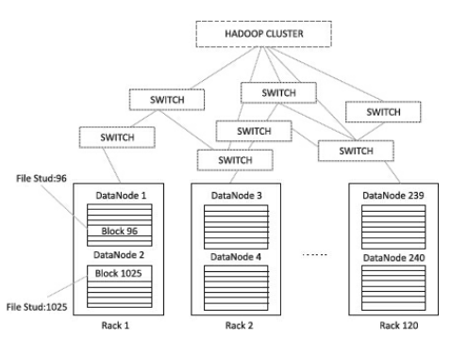
BIG DATA
HDFS – Writing a file

Slide 23
THANK YOU
“WORLD IS ONE BIG DATA PROBLEM”
“TORTURE THE DATA AND IT WILL CONFESS TO ANYTHING”

